Slide 1
PERSONALIZED LEARNING MANAGEMENT SYSTEM
FIRST REVIEW: 20-02-2024
TEAM MEMBERS:
1. ARAVINDH L (953120104006)
2. LAKSHMANAN S (953120104019)
3. MAHESH RAJA V (953120104022)
4. SARAVANA PON BALAN F (953120104044)
GUIDED BY
Mr. R. JEEVA, M.E.,
AP/CSE

Slide 2
ABSTRACT
The Learning Management System (LMS) encompasses various components such as course videos, documents, PDF books, and interactive quizzes. Upon successful completion of final assessments, users are awarded certificates. The LMS employs a content-based filtering technique utilizing a matrix factorization algorithm to effectively understand user preferences and tailor course recommendations accordingly. Moreover, a bot integrated with Natural Language Processing provides assistance by addressing relevant user queries.

Slide 3
ABSTRACT(CONTD.)
The platform further facilitates interaction with mentors, enhancing the overall learning journey. Users are also empowered to create courses, promoting a collaborative learning environment.Notably, the system seamlessly incorporates online compilers, allowing users to engage in practical hands-on exercises with the capability to save their work.

Slide 4
ABSTRACT(CONTD.)
In addition to the features mentioned, this LMS allows users to post content related to technology, such as social media posts, and engage in public discussions and chat with other users, fostering a collaborative and interactive learning environment for technology enthusiasts.

Slide 5
OBJECTIVE OF THE PROJECT
This LMS enhances personalized learning with AI course recommendations, integrated chatbot support, user-generated courses, online compilers, and mentor interactions. We prioritize data offer social media-like features, distinguishing us in the LMS landscape.

Slide 6
PROBLEM STATEMENT
Existing Learning Management Systems (LMS) often lack key features that hinder a collaborative and interactive learning experience. Users are typically restricted in their ability to engage with and learn from each other. Additionally, users cannot easily share their knowledge, experiences, or insights, which limits the platform's potential as a community for learning.

Slide 7
LITERATURE SURVEY
Title : Academia : Web Platform for E-learning.
Author : S. V. Phulari, Abhishek Lavale, Prajwal Gadekar, Abhishek Raut,Kishor Naykodi
Published on: ISSN: 2321-9653, Volume :10, Issue : 1, pp: 284-290, January 2022.
The application is designed for interaction among students and teachers. Its unique feature is streamlined departmental management, facilitating information sharing between teachers and students.

Slide 8
LITERATURE SURVEY
Title : The Acceptance of Social Media Sites: An Empirical Study Using PLS-SEM and ML Approaches.
Author : Sawsan Al-Skaf, Khadija Alhumaid, Enaam Youssef, Mohammed Habes, and Said A. Salloum
Published on: AMLTA 2021, AISC 1339, pp. 548–558, 2021.
Study develops a model for pupils' acceptance of social media in education, extending TAM with social influence. Data from 350 UAE university students analyzed via machine learning and PLS-SEM, highlighting social influence, usefulness, and ease of use.

Slide 9
LITERATURE SURVEY
Title : Use of Artificial Intelligent in Learning Management System (LMS)
Author : Nouf S. Aldahwan, Nourah I. Alsaeed
Published on : Volume 175– No. 13, August 2020
LMS, with AI integration, enhances education but lacks customization. The paper explores AI solutions in LMS, addressing issues and building intelligent learning environments, with future work focusing on architecture and model details.

Slide 10
SCOPE OF THE PROJECT
The project scope encompasses the development of a versatile Learning Management System (LMS) that includes diverse content types, AI-driven personalization, an integrated AI chatbot, mentor interactions, and user-generated course creation. It differentiates itself from existing LMS platforms by offering advanced assessment, assistance, online compilers, and technology-related content sharing, creating a collaborative learning space for technology enthusiasts.

Slide 11
EXISTING SYSTEM
The current educational landscape primarily relies on conventional Learning Management Systems (LMS) with limited technological integration, lacking advanced features like AI-driven personalization, virtual assistants, comprehensive AI-driven assessment, integrated online compilers, and robust data security measures.

Slide 12
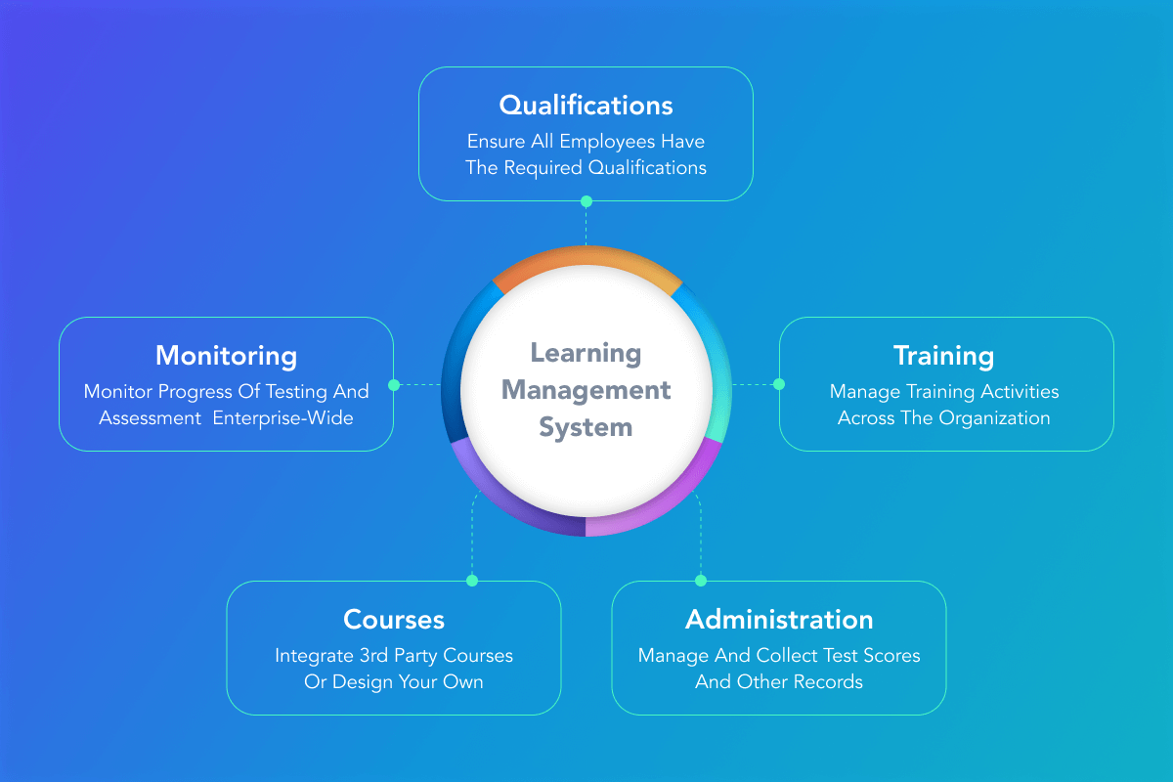
EXISTING SYSTEM(CONTD.)

Slide 13
REQUIREMENTS
Hardware:
Processor : Minimum Intel i3
Hard Disk : Minimum 40GB
RAM : Minimum 4GB
Software:
IDE : VSCode
Frontend : React.js
Backend : Express.js,MongoDB

Slide 14
PROPOSED SYSTEM
The proposed system seeks to modernize education by integrating artificial intelligence into the LMS, introducing features such as personalized recommendations, an AI-powered virtual assistant, mentor interaction, user-generated courses, share post, and online compilers. This forward-looking LMS aims to adapt to the "new normal" by offering a comprehensive learning environment tailored to the evolving needs of learners in a rapidly changing world.

Slide 15






PROPOSED SYSTEM(CONTD.)
Request
Request
Response
Response
Content Creator
Browser
Browser
User
Database
Course videos
User Post
Request
Response
File System
User Interface
server

Slide 16
MODULES
User Management:
Profile: View and manage your account details, progress, and achievements.
Chat: Directly communicate with mentors or content creators for support and guidance.
ChatAssistant: Get assistance with technology-related queries from an AI chatbot.
Notifications: Receive updates on course enrollments, messages, and other relevant activities.

Slide 17
MODULES
Course Management:
Access and participate in learning modules or create your own courses.
Feed: Share updates, achievements, and engage with others on the platform.
Progress Tracking: Monitor your progress within courses, track completed modules, and set learning goals.
Collaboration Tools: Collaborate with peers on projects, assignments, or discussions within courses.

Slide 18
MODULES
CodeCraft:
Practice coding in programming such as Python and Node.js.
Store code snippets for future reference and practice sessions.

Slide 19
MODULES
Recommendation System:
Utilize content-based filtering technique to recommend courses and learning materials based on the user's past interactions, preferences, and the content similarity of courses.
It analyzes the content of courses, modules, and resources to understand their topics, difficulty levels, and relevance to specific skills or interests.

Slide 20
REFERENCES
[1]
[2]
[3]
S. V. Phulari, Abhishek Lavale, Prajwal Gadekar, Abhishek Raut, Kishor Naykodi, “Academia : Web Platform for E-learning.” ISSN: 2321-9653, Volume :10, Issue : 1, pp: 284-290, January 2022.
Sawsan Al-Skaf, Khadija Alhumaid, Enaam Youssef, Mohammed Habes, and Said A. Salloum, “The Acceptance of Social Media Sites: An Empirical Study Using PLS-SEM and ML Approaches” AMLTA 2021, AISC 1339, pp. 548–558, 2021.
Nouf S. Aldahwan, Nourah I. Alsaeed, “Use of Artificial Intelligent in Learning Management System (LMS): A Systematic Literature Review” Volume 175– No. 13, August 2020

